Slide 1
Green’s Functions
Jules Hunter & Marco-Antonio Sahagun

Slide 2
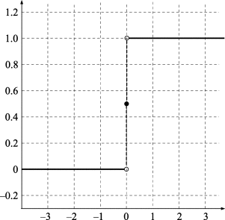
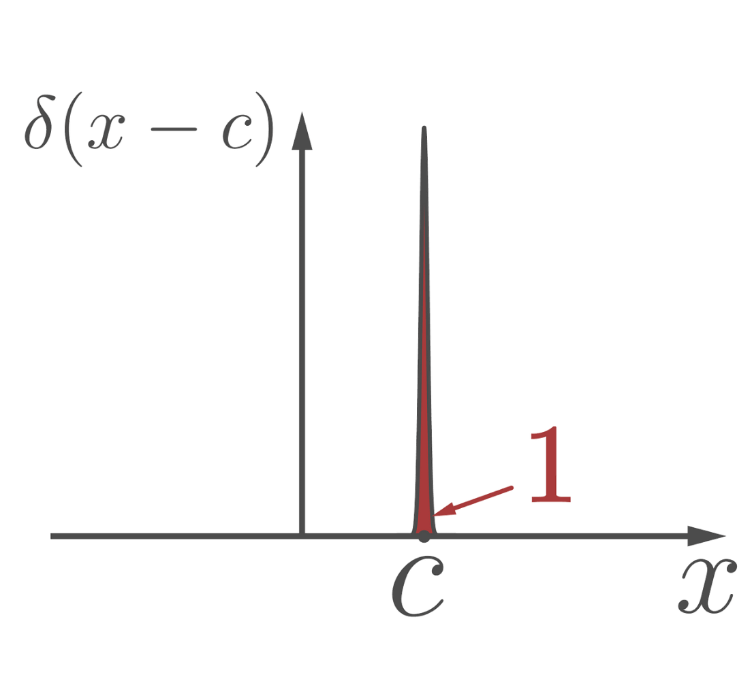
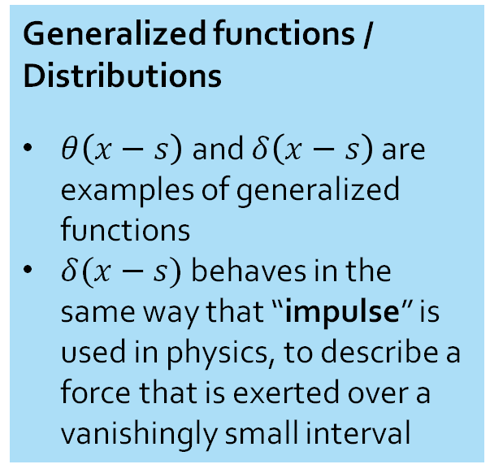
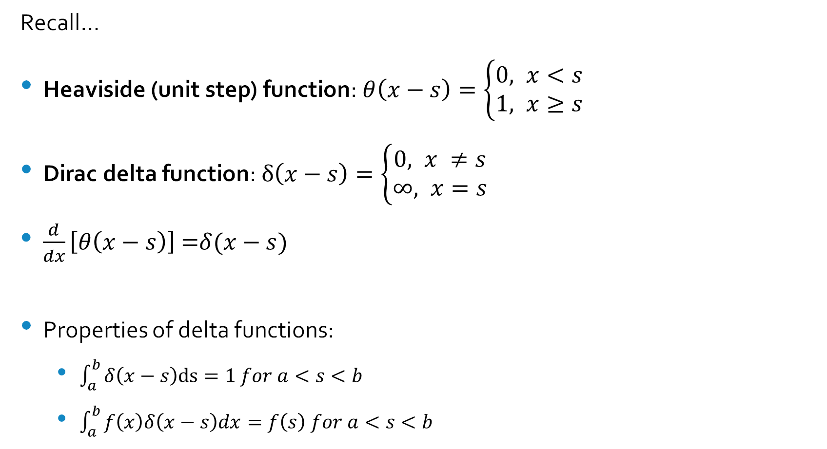
Context
Recall…
Heaviside (unit step) function: $θ\left(x−s\right)=\left\{\begin{aligned}0, x<s \\ &1, x≥s\end{aligned}\right.$
Dirac delta function: $δ\left(x−s\right)=\left\{\begin{aligned}0, x ≠s \\ &∞, x=s\end{aligned}\right.$
$\frac{d}{dx}\left[θ\left(x−s\right)\right]$ =$δ(x−s)$
Properties of delta functions:
$\int_{a}^{b}{δ\left(x−s\right)\text{ds}=1 for a<s<b}$
$\int_{a}^{b}{f\left(x\right)δ\left(x−s\right)dx=f\left(s\right) for a<s<b}$
Generalized functions / Distributions
$θ\left(x−s\right)$and $δ\left(x−s\right)$ are examples of generalized functions
$δ(x−s)$ behaves in the same way that “impulse” is used in physics, to describe a force that is exerted over a vanishingly small interval

Slide 3
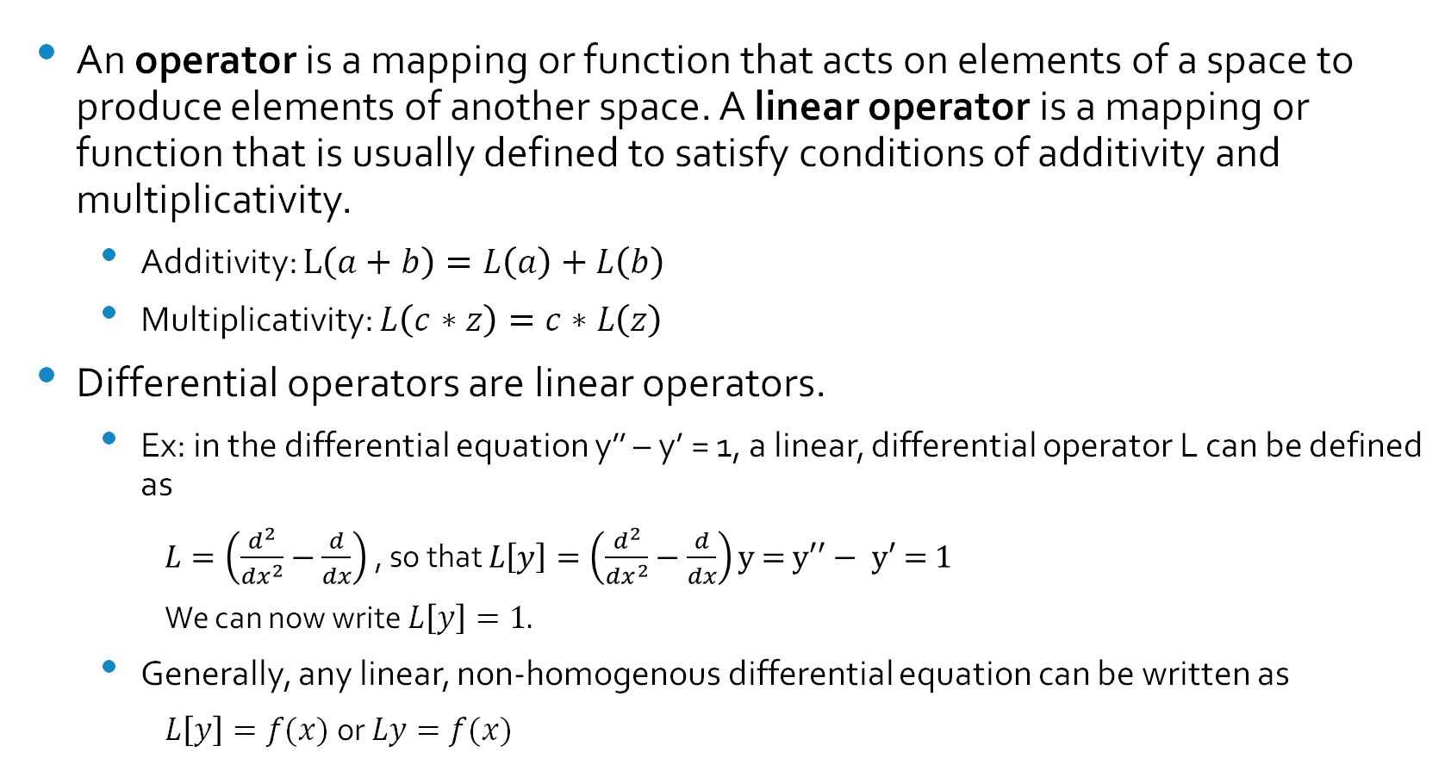
Linear operators
An operator is a mapping or function that acts on elements of a space to produce elements of another space. A linear operator is a mapping or function that is usually defined to satisfy conditions of additivity and multiplicativity.
Additivity: $L\left(a+b\right)=L\left(a\right)+L\left(b\right)$
Multiplicativity: $L\left(c∗z\right)=c∗L\left(z\right)$
Differential operators are linear operators.
Ex: in the differential equation y’’ – y’ = 1, a linear, differential operator L can be defined as
$L=\left(\frac{d^{2}}{dx^{2}}−\frac{d}{dx}\right)$ , so that $L\left[y\right]=\left(\frac{d^{2}}{dx^{2}}−\frac{d}{dx}\right)\text{y}\text{ = }\text{y}\text{′′}− \text{y}\text{′ = 1}$
We can now write $L\left[y\right]=1.$
Generally, any linear, non-homogenous differential equation can be written as
$L\left[y\right]=f(x)$ or $Ly=f(x)$

Slide 4
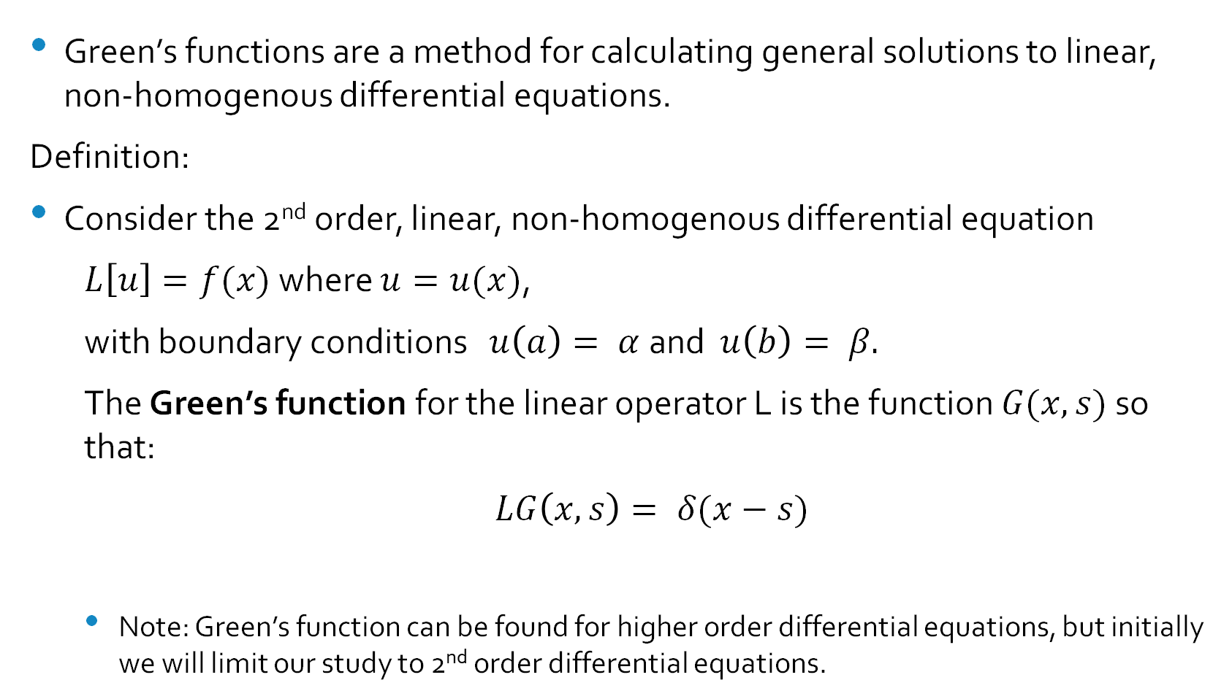
Green’s Functions
Green’s functions are a method for calculating general solutions to linear, non-homogenous differential equations.
Definition:
Consider the 2nd order, linear, non-homogenous differential equation
$L\left[u\right]=f(x)$ where $u=u(x)$,
with boundary conditions $u\left(a\right)= α$and $u\left(b\right)= β.$
The Green’s function for the linear operator L is the function $G(x, s)$ so that:
$LG\left(x, s\right)= δ(x−s)$
Note: Green’s function can be found for higher order differential equations, but initially we will limit our study to 2nd order differential equations.

Slide 5
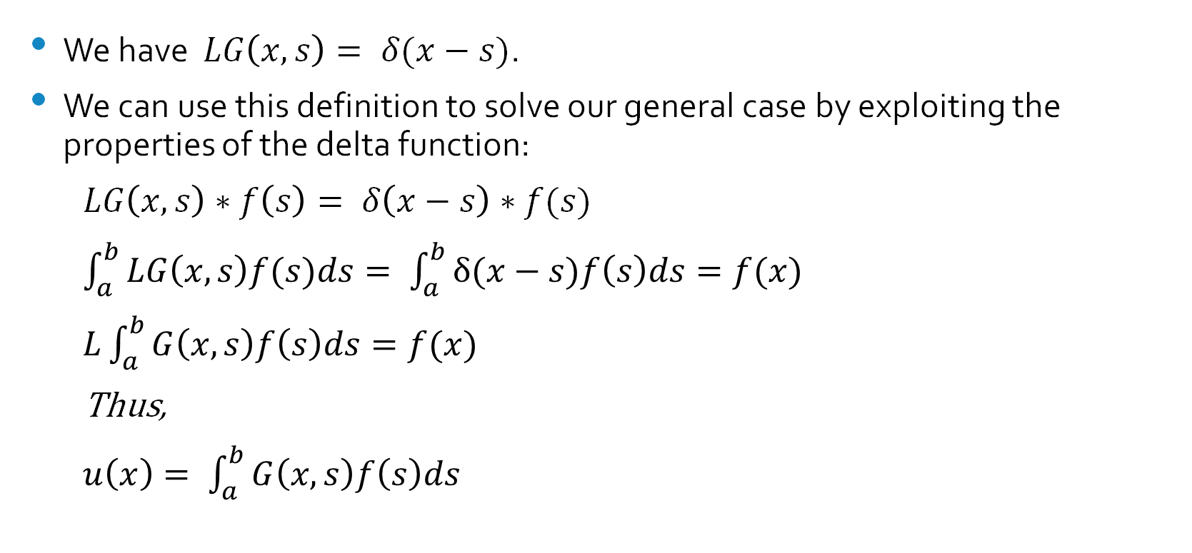
Green’s functions cont.
We have $LG\left(x, s\right)= δ(x−s)$.
We can use this definition to solve our general case by exploiting the properties of the delta function:
$LG\left(x,s\right)∗f\left(s\right)= δ\left(x−s\right)∗f(s)$
$\int_{a}^{b}{LG\left(x,s\right)f(s)ds}= \int_{a}^{b}{δ(x−s)f\left(s\right)ds}=f(x)$
$L\int_{a}^{b}{G\left(x, s\right)f\left(s\right)ds=f(x)}$
Thus,
$u\left(x\right)= \int_{a}^{b}{G\left(x, s\right)f\left(s\right)ds}$

Slide 6
Partial and Ordinary Differential Equations
Quantum Mechanics
Electro Dynamics
Signals Processing
Heat Transfer
And more!

Slide 7

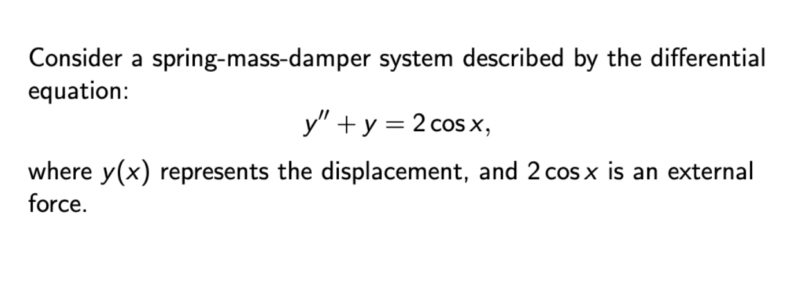

Slide 8
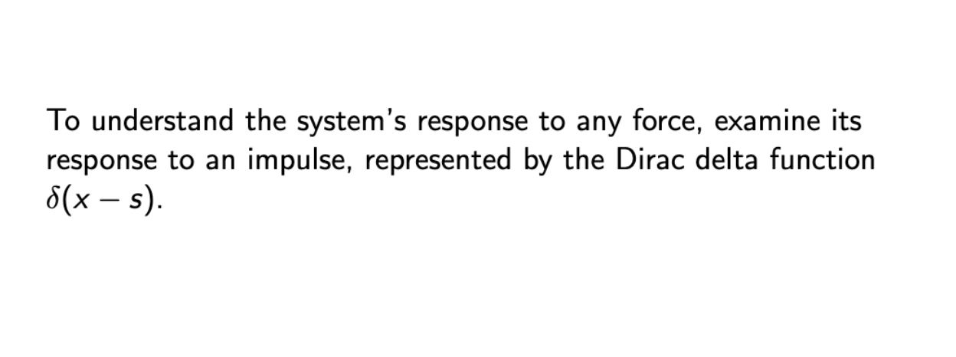

Slide 9
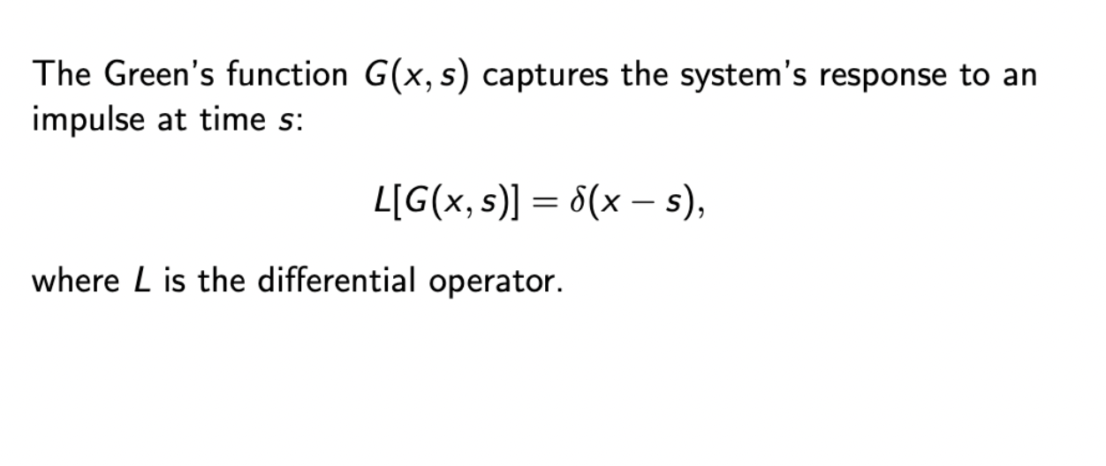

Slide 10
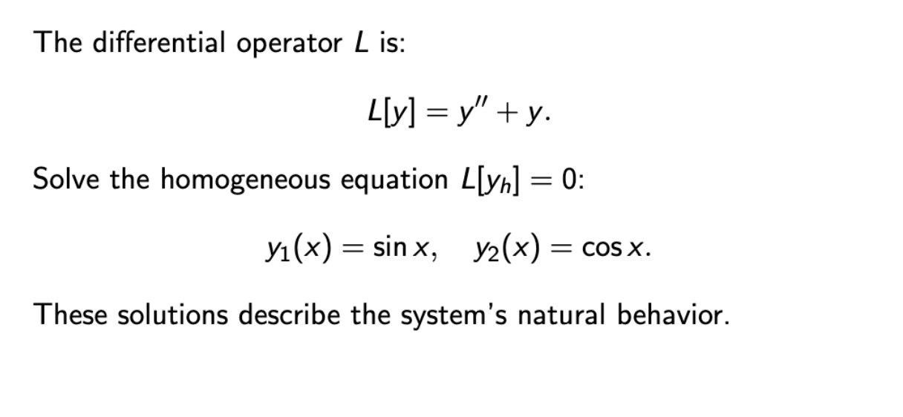

Slide 11
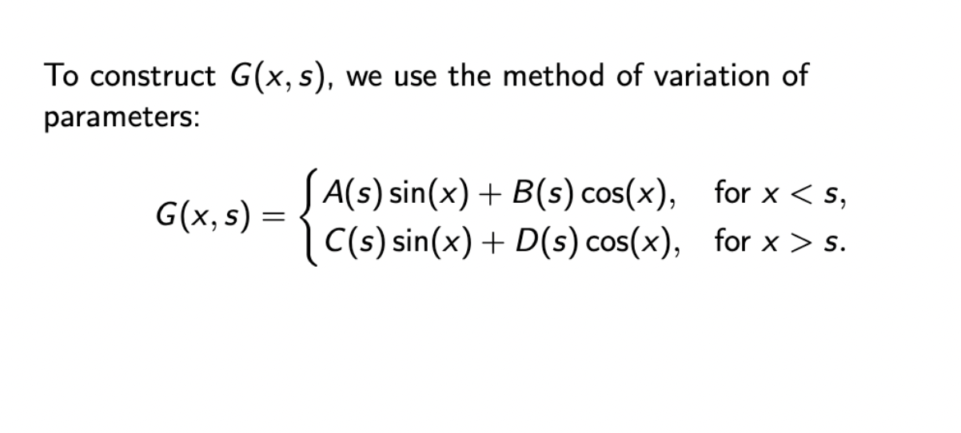

Slide 12
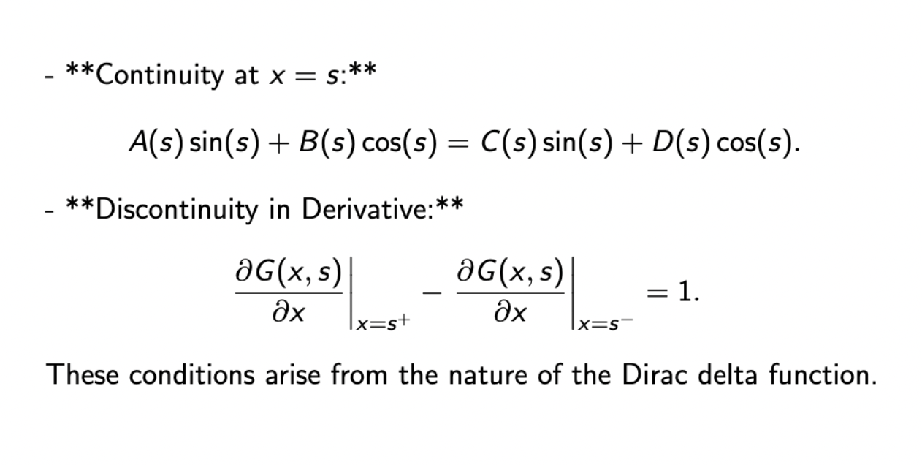

Slide 13
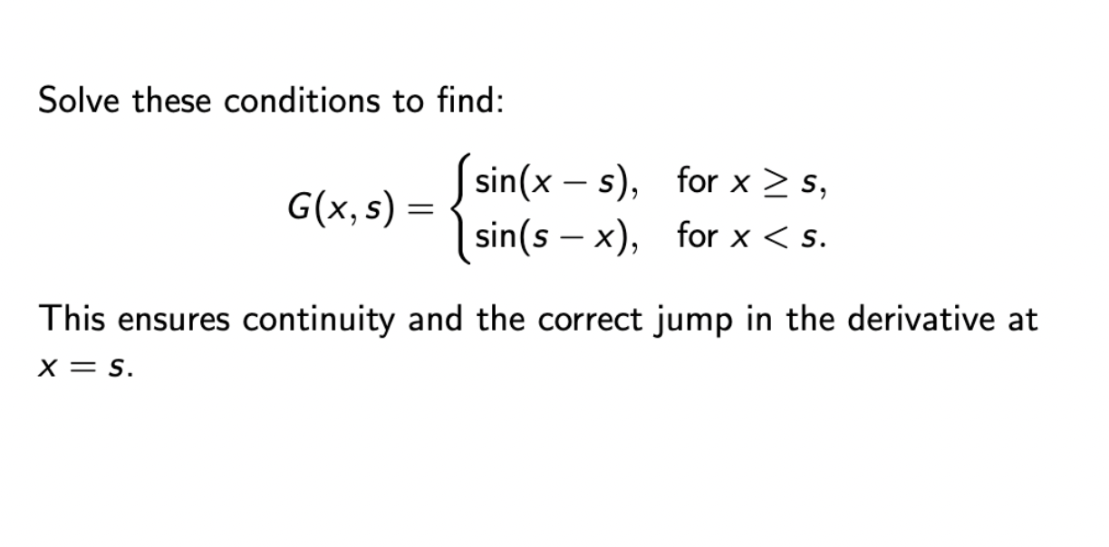

Slide 14
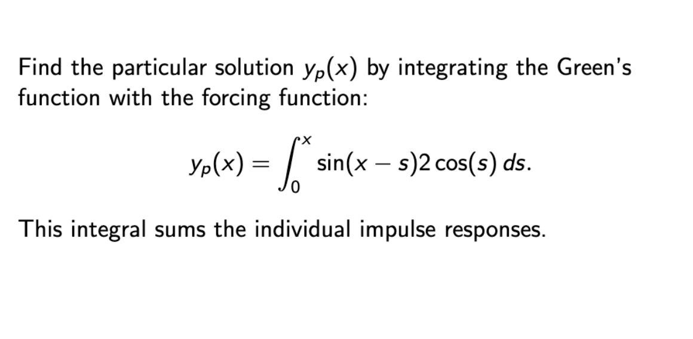

Slide 15
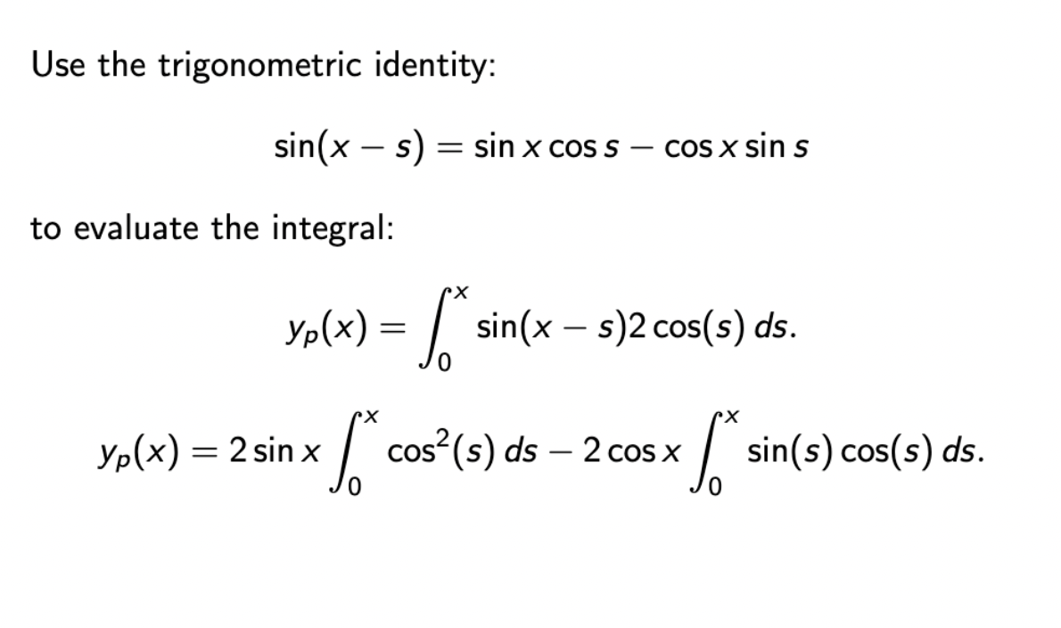

Slide 16
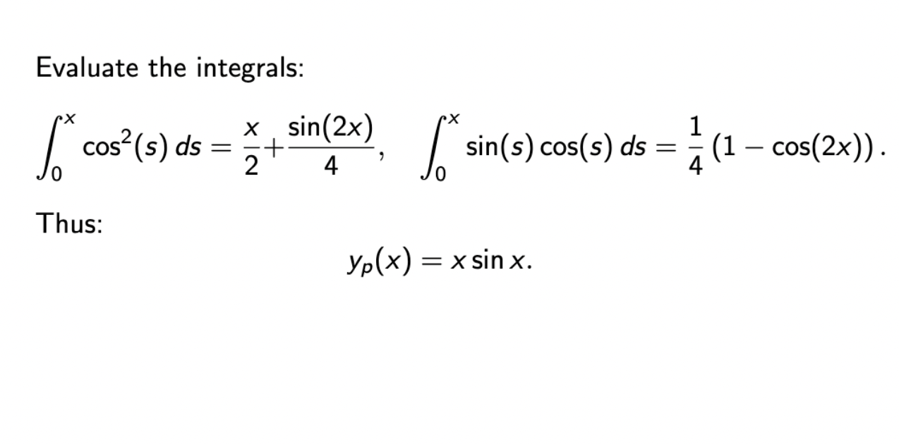

Slide 17
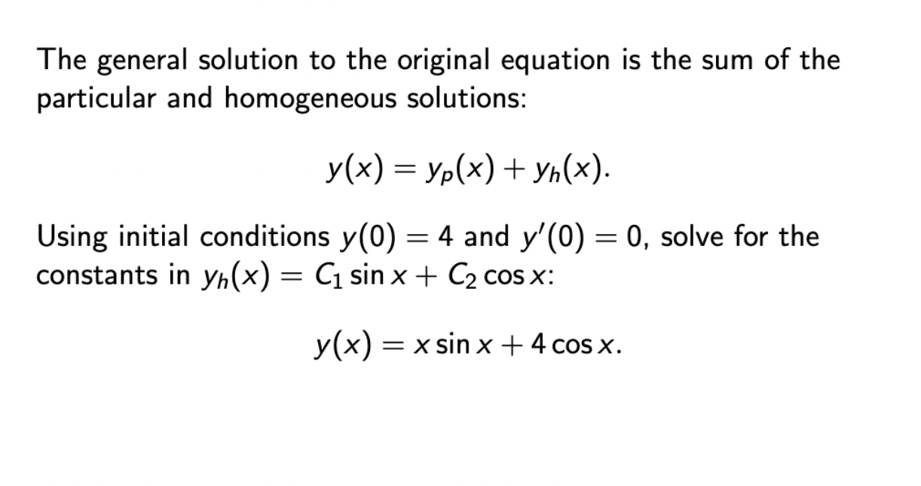

Slide 18
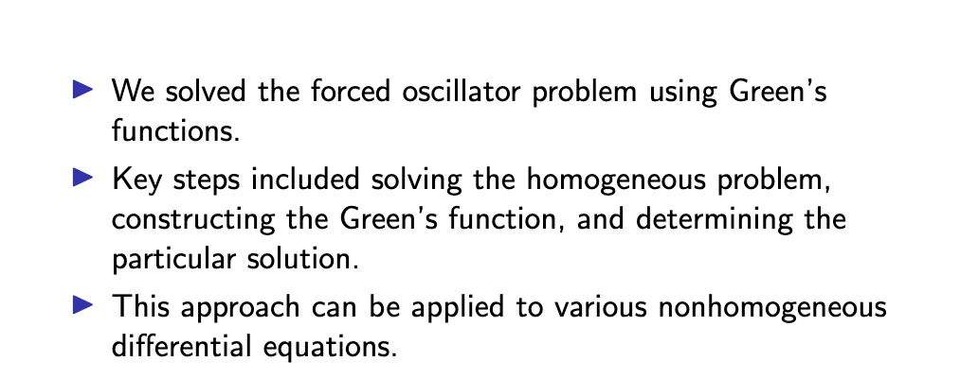

Slide 19
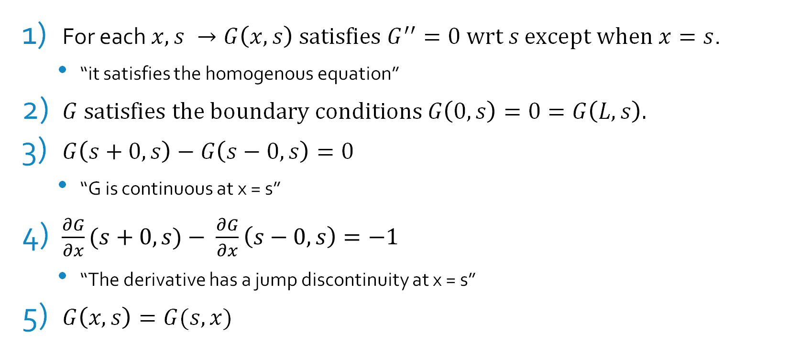
Properties of Green’s functions
For each $x, s →G\left(x, s\right) \text{satisfies} G^{′′}=0 \text{wrt} s$ $\text{except} \text{when} x=s$.
“it satisfies the homogenous equation”
$G \text{satisfies} \text{the} \text{boundary} \text{conditions} G\left(0, s\right)=0=G\left(L, s\right).$
$G\left(s+0, s\right)−G\left(s−0, s\right)=0$
“G is continuous at x = s”
$\frac{∂G}{∂x}(s+0, s)− \frac{∂G}{∂x}\left(s−0, s\right)=−1$
“The derivative has a jump discontinuity at x = s”
$G\left(x, s\right)=G(s, x)$

Slide 20
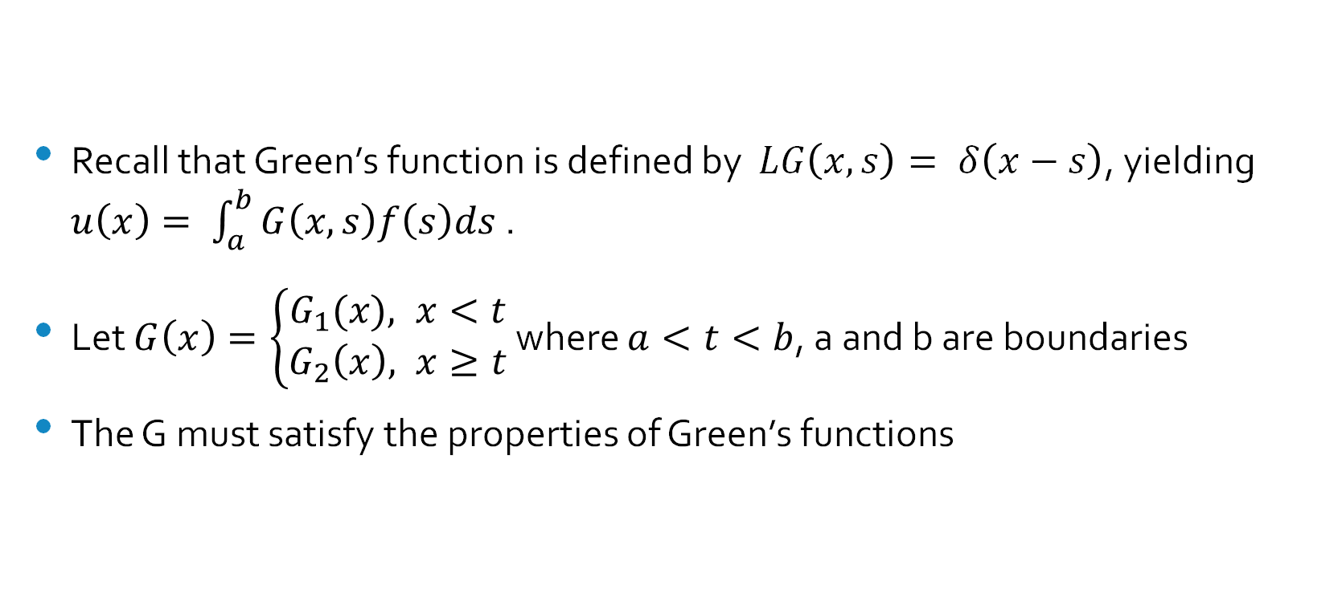
Computing Green’s Function - BVPs
Recall that Green’s function is defined by $LG\left(x, s\right)= δ\left(x−s\right)$, yielding $u\left(x\right)= \int_{a}^{b}{G\left(x, s\right)f\left(s\right)ds}$ .
Let $G\left(x\right)=\left\{\begin{aligned}G_{1}(x), x<t \\ G_{2}\left(x\right), x≥t\end{aligned}\right.$ where $a<t<b$, a and b are boundaries
The G must satisfy the properties of Green’s functions

Slide 21
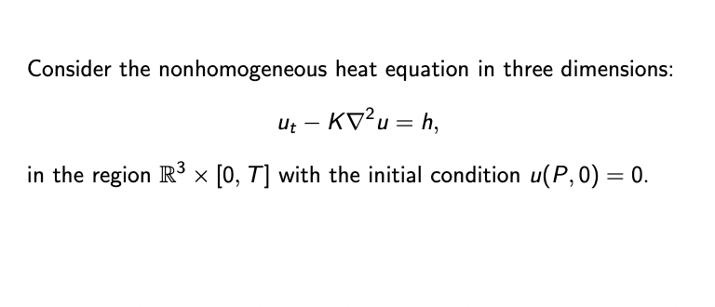

Slide 22
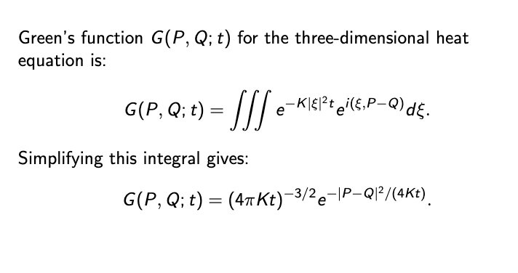

Slide 23
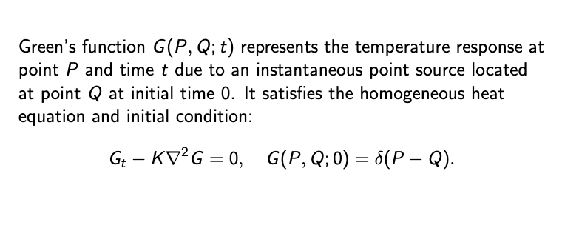

Slide 24
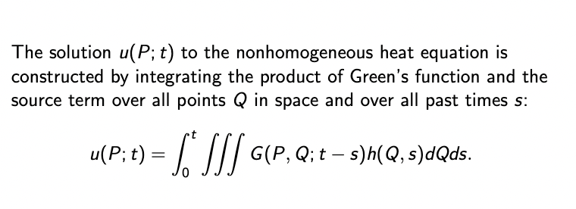

Slide 25
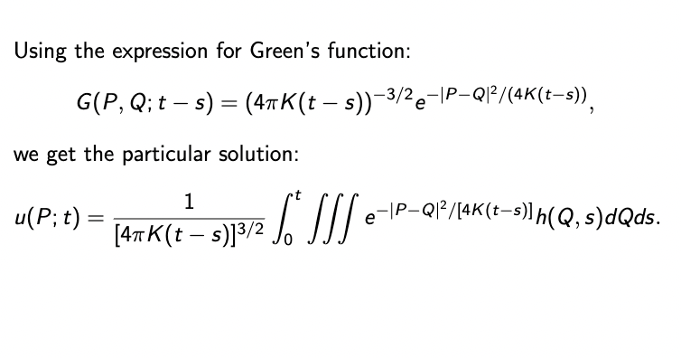

Slide 26
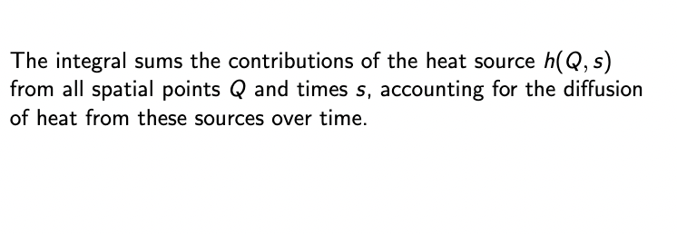

Slide 27
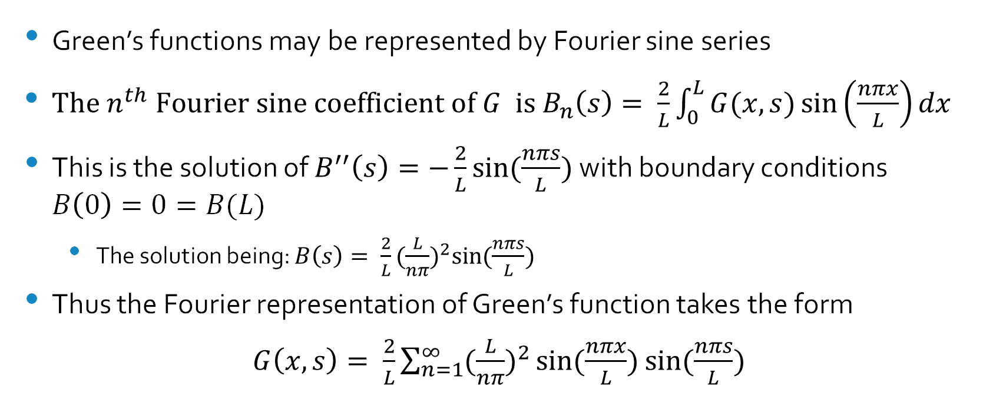
Fourier representation of Green’s functions
Green’s functions may be represented by Fourier sine series
$\text{The} n^{th} \text{Fourier} \text{sine} \text{coefficient} \text{of} G \text{is} B_{n}\left(s\right)= \frac{2}{L}\int_{0}^{L}{G(x, s)\sin\left(\frac{nπx}{L}\right)dx}$
This is the solution of $B^{′′}\left(s\right)=−\frac{2}{L}\sin{(\frac{nπs}{L})}$ with boundary conditions $B\left(0\right)=0=B(L)$
The solution being: $B\left(s\right)= \frac{2}{L}{(\frac{L}{nπ})}^{2}\sin{(\frac{nπs}{L})}$
Thus the Fourier representation of Green’s function takes the form
$G\left(x, s\right)= \frac{2}{L}\sum_{n=1}^{∞}{{(\frac{L}{nπ})}^{2}}\sin{(\frac{nπx}{L})}$ $\sin{(\frac{nπs}{L})}$

Slide 28
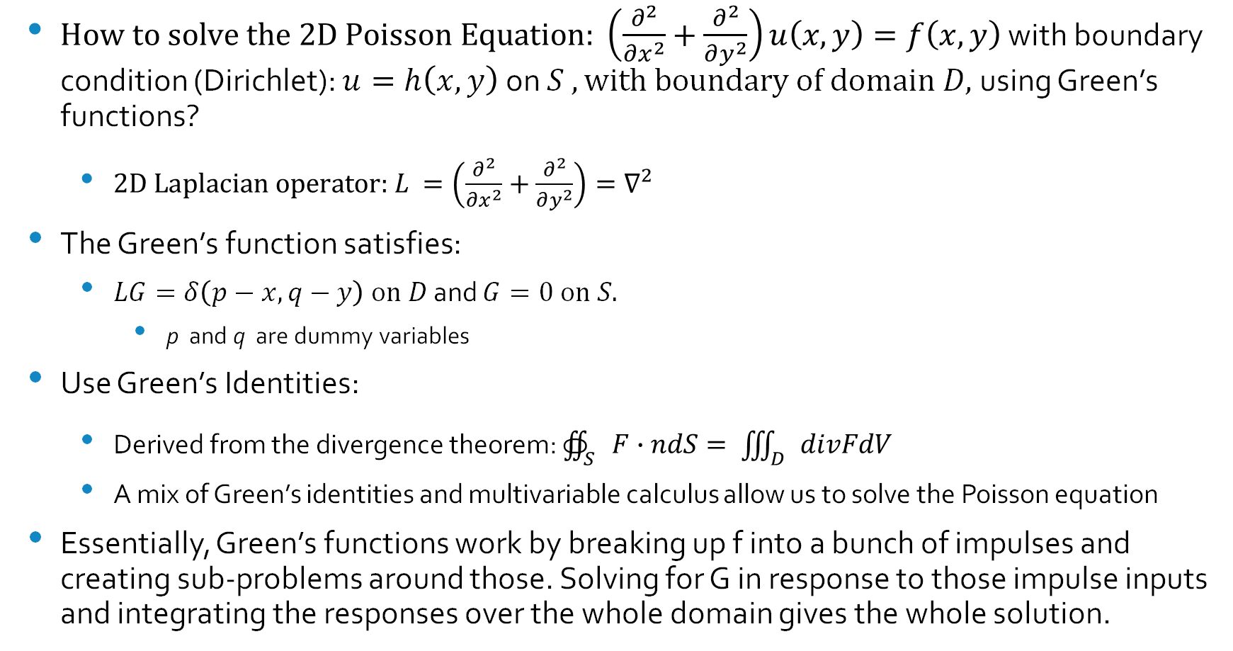
Using Green’s functions for PDE’s – Poisson Strategy
$\text{How} \text{to} \text{solve} \text{the}\text{ 2}\text{D} \text{Poisson} \text{Equation}\text{: }\left(\frac{∂^{2}}{∂x^{2}}+\frac{∂^{2}}{∂y^{2}}\right)u\left(x, y\right)=f\left(x, y\right)$ with boundary condition (Dirichlet): $u=h\left(x, y\right)$on $S , \text{with} \text{boundary} \text{of} \text{domain} D,$using Green’s functions?
$\text{2}\text{D} \text{Laplacian} \text{operator}\text{: }L =\left(\frac{∂^{2}}{∂x^{2}}+\frac{∂^{2}}{∂y^{2}}\right)=∇^{2}$
The Green’s function satisfies:
$LG=δ\left(p−x, q−y\right) \text{on} D$ and $G=0 \text{on} S.$
p and q are dummy variables
Use Green’s Identities:
Derived from the divergence theorem: $∯_{S}{F∙ndS}= \iiint_{D}{divFdV}$
A mix of Green’s identities and multivariable calculus allow us to solve the Poisson equation
Essentially, Green’s functions work by breaking up f into a bunch of impulses and creating sub-problems around those. Solving for G in response to those impulse inputs and integrating the responses over the whole domain gives the whole solution.

Slide 29
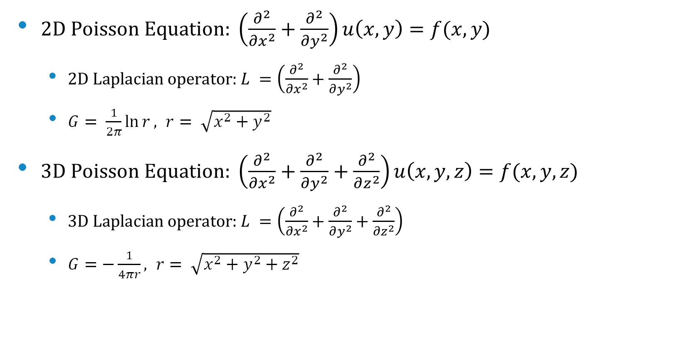
Important Green’s Functions
$\text{2}\text{D} \text{Poisson} \text{Equation}\text{: }\left(\frac{∂^{2}}{∂x^{2}}+\frac{∂^{2}}{∂y^{2}}\right)u\left(x, y\right)=f(x, y)$
$\text{2}\text{D} \text{Laplacian} \text{operator}\text{: }L =\left(\frac{∂^{2}}{∂x^{2}}+\frac{∂^{2}}{∂y^{2}}\right)$
$G= \frac{1}{2π}\ln{r}, r= \sqrt{x^{2}+y^{2}}$
$\text{3}\text{D} \text{Poisson} \text{Equation}\text{: }\left(\frac{∂^{2}}{∂x^{2}}+\frac{∂^{2}}{∂y^{2}}+\frac{∂^{2}}{∂z^{2}}\right)u\left(x, y, z\right)=f(x, y, z)$
$\text{3}\text{D} \text{Laplacian} \text{operator}\text{: }L =\left(\frac{∂^{2}}{∂x^{2}}+\frac{∂^{2}}{∂y^{2}}+\frac{∂^{2}}{∂z^{2}}\right)$
$G=−\frac{1}{4πr}, r= \sqrt{x^{2}+y^{2}+z^{2}}$

Slide 30
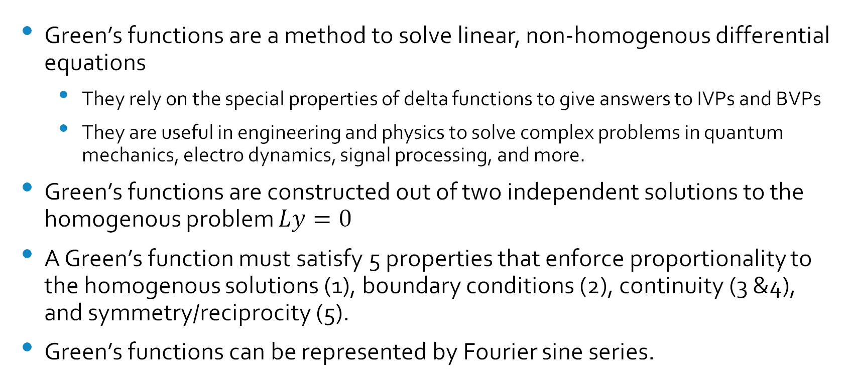
Summary
Green’s functions are a method to solve linear, non-homogenous differential equations
They rely on the special properties of delta functions to give answers to IVPs and BVPs
They are useful in engineering and physics to solve complex problems in quantum mechanics, electro dynamics, signal processing, and more.
Green’s functions are constructed out of two independent solutions to the homogenous problem $Ly=0$
A Green’s function must satisfy 5 properties that enforce proportionality to the homogenous solutions (1), boundary conditions (2), continuity (3 &4), and symmetry/reciprocity (5).
Green’s functions can be represented by Fourier sine series.

Slide 31
Sources
Text
“Partial Differential Equations and Boundary-Value Problems with Applications (Third Edition),” Chapter 8: Green’s Functions, Mark A. Pinsky
“Partial Differential Equations,” Schaum’s Outlines, Paul DuChateau, David W. Zachmann
“Boundary Value Problems and Partial Differential Equations,” Mayer Humi, William B. Biller
Video
“Introduction to Greens Functions from a simple example,” Daniel An, https://youtu.be/3pcokxvGD1k?si=NVFW2gv7hkKHjyO0
“Green’s Functions | Chapter 3 Differential Equations,” Sabetta Talks Math, https://youtu.be/E0helmznQAs?si=YMxte3QlMkTwzkKg
“Green’s function for Sturm-Liouville problems,” Nathan Kutz, https://youtu.be/8l4VsNSX_kw?si=irzuUuN7p8r7sPRS
“Section 4.8 – Green’s Functions – Part 1,” Professor Yenerall’s Math Help, https://youtu.be/gc1eoe-C5-Q?si=lgZRHLSzvukc0W0Y

